Slide 1
CH5_EX1

Slide 2
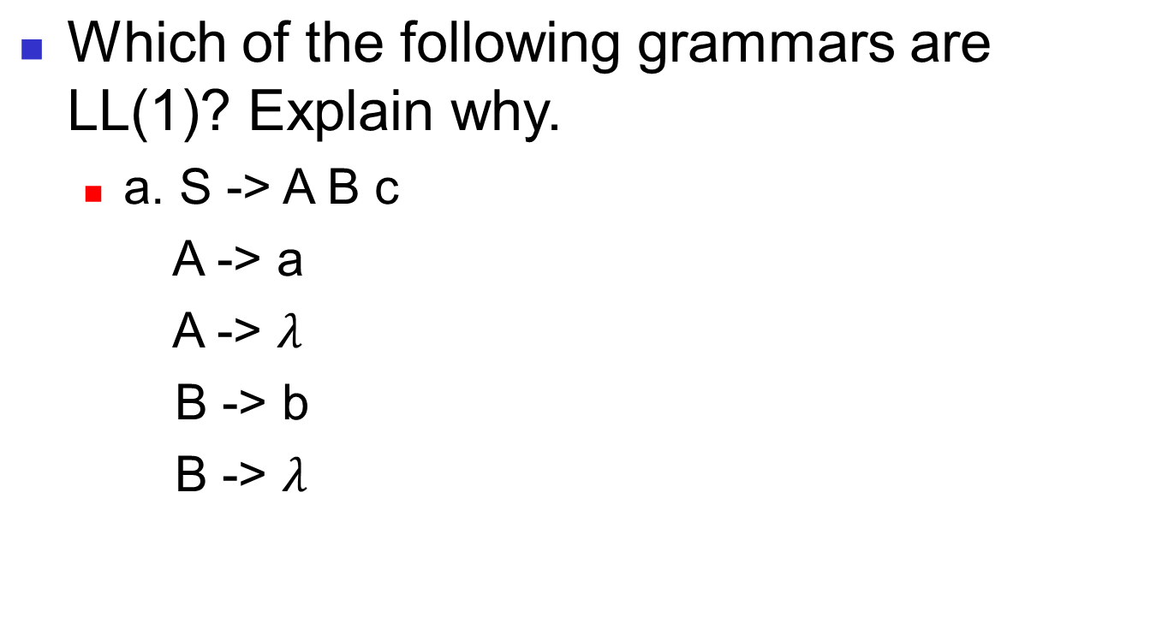
Compiler
CH5_EX1 - <number>

Slide 3

Compiler
CH5_EX1 - <number>

Slide 4

Compiler
CH5_EX1 - <number>

Slide 5
Compiler
Which of the following grammars are LL(1)? Explain why.
  d. S -> a S e
    S -> B
    B -> b B e
    B -> C
    C -> c C e
    C -> d
CH5_EX1 - <number>

